Slide 1
Scaling up and out,
and how Valkey does both
Madelyn Olson
Valkey Engineer

Slide 2

Madelyn Olson (she/her)
Valkey maintainer
Principal engineer at AWS
Original co-creator of the Valkey fork
I love hearing diverse opinions about performance
I enjoy hiking, nature, and good wine
Notes:
Buenas tardes. Me llamo Madelyn Olson. Soy de los Estados Unidos.
Estoy muy emocionada de estar acá en Nerdearla. Me gusta mucho el trekking, la montaña y el buen vino. Argentina es perfecta para mí. Ya probé el Malbec. Es muy, muy bueno.
Y estoy muy feliz de compartir mi amor por el open source con todos ustedes.
Gracias por dejarme practicar mi español oxidado. Ahora, el resto de la charla va a ser en inglés.

Slide 3

Introducing the Valkey project
Drop-in compatible
Vendor neutral
Built in the open
Fully compatible with Redis OSS 7.2, and always will be.
A Linux Foundation project, BSD-3 licensed, so it stays open source.
Nine technical steering committee members, from eight companies.
Notes:
Three key points about Valkey:
1. It's fully compatible with Redis OSS 7.2, and will always be.
2. It's backed by the Linux Foundation, so it will remain open source and vendor neutral.
3. It has a diverse backing. There are nine technical steering members, from eight companies.

Slide 4
A customer latency story
time
Notes:
This is the shape that starts every one of these conversations. The average is fine. The customer is not.

Slide 5
Latency is a cliff
* Latency capped at 5ms
Notes:
Clients in the same availability zone as the server.

Slide 6
Steady state is a lie

Slide 7
You could overprovision
Notes:
We would like customers to be able to over provision their clusters. This is what it costs.

Slide 8
Two axes, and neither one is optional
Vertical Scaling
Horizontal Scaling
Add more cores to handle incoming requests
Limited with IO threading
Add more hosts to handle requests
No cross-shard transactions
Slow and dangerous to scale

Slide 9
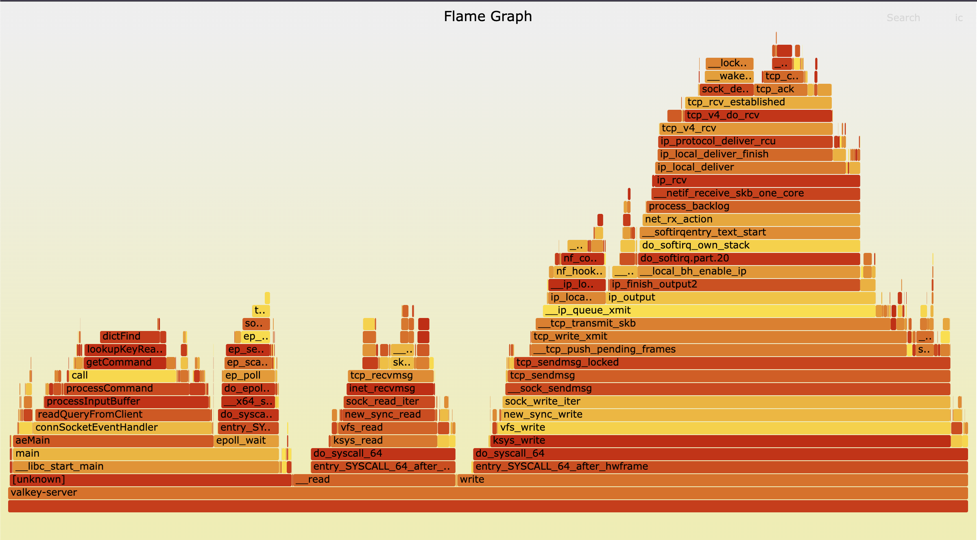
Parse and execute command
Epoll
Read command
Send response
perf flame graph, valkey-server under valkey-benchmark GET.
Notes:
Single threaded vs multi-threaded phases. Only the leftmost band has to be serialised; the rest is I/O and kernel network stack, and that is what moved to the IO threads.

Slide 10
Thread scalable command processing
Main Thread
System Epoll
Read Client Command
Parse Command
Execute Command
Send response

Slide 11
Thread scalable command processing
Main Thread
IO Thread 1
System Epoll
Read Client Command
Read Client Command
Parse Command
Parse Command
Execute Command
Execute Command
Send response
Notes:
Single threaded vs multi-threaded phases.

Slide 12
Thread scalable command processing
Main Thread
System Epoll
Read Client Command
Parse Command
Execute Command
Send response

Slide 13
Thread scalable command processing
Main Thread
IO Thread 1
System Epoll
Read Client Command
Parse Command
Execute Command
Send response

Slide 14
Thread scalable command processing
Main Thread
IO Thread 1
System Epoll
Read Client Command
Execute Command
Parse Command
Execute Command
Send response
Read Client Command
Read Client Command
Parse Command
Parse Command
Send response
Send response

Slide 15
Thread scalable command processing
Main Thread
IO Thread 1
IO Thread 2
System Epoll
Read Client Command
Execute Command
Parse Command
Execute Command
Send response
Read Client Command
Read Client Command
Parse Command
Parse Command
Send response
Send response

Slide 16
Thread scalable command processing
Main Thread
IO Thread 1
IO Thread 2
Execute Command
System Epoll
Read Client Command
Execute Command
Read Client Command
Parse Command
Execute Command
Parse Command
Send response
Execute Command
Send response
Read Client Command
Execute Command
Read Client Command
Parse Command
Execute Command
Parse Command
Send response

Slide 17
The host looks idle. The main thread is full.
host CPU
used_active_main_thread
200% of 400%
main thread
99%
io thread 1
36%
4 cores pinned
200%
io thread 2
34%
io thread 3
31%

Slide 18
Latency is (still) a cliff though
* Latency capped at 5ms

Slide 19
Adapt the requirements to the workload

Slide 20
Up: about 8x, and then it stops
Vertical Scaling
Horizontal Scaling
Add more cores to handle incoming requests
Limited with IO threading Provides about 8x throughput scaling
Add more hosts to parallelize requests
No cross-shard transactions
Slow and dangerous to scale

Slide 21
Clustering
slots 0 – 5460
slots 5461 – 10922
slots 10923 – 16383
Primary
Primary
Primary
shard 1
shard 2
shard 3
Replica
Replica
Replica
read + failover
read + failover
read + failover

Slide 22
Every key belongs to exactly one slot
GET "user:42"
CRC16(key) mod 16384
slot 9158
shard 2
Scaling out moves slots, not keys. A client that asks the wrong shard gets MOVED and retries.
Notes:
16384 slots, fixed. The mapping from key to slot never changes; only the mapping from slot to shard does. That is what every migration slide after this is about.

Slide 23
CLUSTER GETKEYSINSLOT
slot 5461
list every key in the slot
Shard 1
Shard 2
source
target
MIGRATING
IMPORTING
GETKEYSINSLOT
MIGRATE

Slide 24
MIGRATE
slot 5461
one key per MIGRATE, clients follow -ASK
Shard 1
Shard 2
source
target
MIGRATING
IMPORTING
GETKEYSINSLOT
MIGRATE

Slide 25
CLUSTER SETSLOT STABLE
slot 5461
keys must be moved back by hand
Shard 1
Shard 2
source
target
still owns the slot
holds keys it does not own
GETKEYSINSLOT
MIGRATE

Slide 26
CLUSTER MIGRATESLOTS
slots 5461 – 10922
slot migration link established
Shard 1
Shard 2
source
target
still owns the slots
staging area created
Initializing
Snapshotting
Streaming changes
Finalized

Slide 27
CLUSTER SYNCSLOTS
slots 5461 – 10922
snapshot, then live stream of mutations
Shard 1
Shard 2
source
target
still owns the slots
staging area
Initializing
Snapshotting
Streaming changes
Finalized

Slide 28
CLUSTER SYNCSLOTS
slots 5461 – 10922
caught up, ownership handed over
Shard 1
Shard 2
source
target
paused, then drops its copy
owns the slots
Initializing
Snapshotting
Streaming changes
Finalized

Slide 29
CLUSTER CANCELSLOTMIGRATIONS
slots 5461 – 10922
transfer abandoned
Shard 1
Shard 2
source
target
never stopped owning them
staging area discarded
Initializing
Snapshotting
Streaming changes
Failed

Slide 30
Legacy vs atomic slot migration
No load
Heavy load
3 → 4 shards
3 → 4 shards
legacy
1m 42s
legacy
2m 27s
atomic
11s 9.5x faster
atomic
31s 4.8x faster
4 → 3 shards
4 → 3 shards
legacy
1m 20s
legacy
2m 05s
atomic
10s 8.4x faster
atomic
27s 4.6x faster
Valkey 9.0, c4-standard-8, 40 GB of 16 KB values, valkey-cli --cluster rebalance defaults. Source: valkey.io/blog/atomic-slot-migration

Slide 31
Horizontal scaling, in and out: now fast and safe
Vertical Scaling
Horizontal Scaling
Add more cores to handle incoming requests
Limited with IO threading Provides about 8x throughput scaling
Add more hosts to parallelize requests
No cross-shard transactions
Slow and dangerous to scale Fast and safe operation

Slide 32
CLUSTER SLOT-STATS
key-count
cpu-usec
slot 12703
20,450
slot 12703
41,200 us
slot 4488
19,980
slot 4488
9,800 us
slot 9021
20,310
slot 9021
8,100 us
slot 15330
19,740
slot 15330
7,400 us
slot 702
20,120
slot 702
6,900 us

Slide 33
Introducing the Valkey Operator
github.com/valkey-io/valkey-operator
Scaling
Upgrades and failover
TLS and ACLs, declared
Set spec.shards. The operator rebalances slots on the way out and drains them on the way in.
Replicas roll before primaries, with a proactive failover before the primary goes.
Certificates and users live in the spec. ACL changes apply without a restart.
v0.6.0, alpha and not production ready
Notes:
Alpha. Breaking API changes and data loss are both called out in the project's own release notes, so do not oversell it. The point is that the slot migration primitives from the last section are something a controller drives for you, not a runbook you follow.

Slide 34
Valkey’s architectural goals
Efficiency trumps headline numbers
Make scaling operations seamless
Keep the command execution simple

Slide 35

Getting involved
Start at valkey.io
Talk to contributors on Slack: valkey.io/slack
ValkeyConf 2026, 5 October, Prague
valkey.io/connect
Notes:
Point people at the site first; it links everything else, including GitHub Discussions, Matrix and the issue tracker. Slack is where contributors actually talk. ValkeyConf is the only item with a date.

Slide 36
Thank you! Let’s connect.
Madelyn Olson
@reconditerose (X and Bluesky)
madelynolson.com

